Slide 1
Smart Vaccum Cleaner Robot using IOT
Guided By :
Dr.K.LALITHA
PRESENTED By :
22AI009-Deepakkumar.M
. 22AI016-Gokulraj.V
. 22AI020-Kavinkumar.G
TEAM NO : 7
22AIC14 : Internet of Things & It’s Application

Slide 2
Abstract
*The Smart Vacuum Cleaner is an autonomous cleaning device designed to simplify household chores.
*It uses sensors for navigation, motors for movement, and IoT for remote control.
* The device efficiently detects obstacles and covers maximum floor area, providing a convenient and time-saving solution for home cleaning.

Slide 3
Objectives:
Develop an Autonomous Cleaning SystemEnable automatic navigation and cleaning without manual intervention.
Integrate Obstacle DetectionUse sensors to detect and avoid obstacles during operation.
Implement IoT FeaturesAllow remote control and scheduling through a mobile app or voice commands.
Optimize Cleaning EfficiencyEnsure the cleaner covers maximum floor area and operates with energy efficiency.

Slide 4
Components Required:
Microcontroller: Manages operations. Sensors: For obstacle detection and cliff avoidance. Motors: For movement and vacuuming. Battery: Powers the device. Charging Dock: For automatic recharging. IoT Module: For remote control (Wi-Fi/Bluetooth). Dustbin: Collects debris.

Slide 5
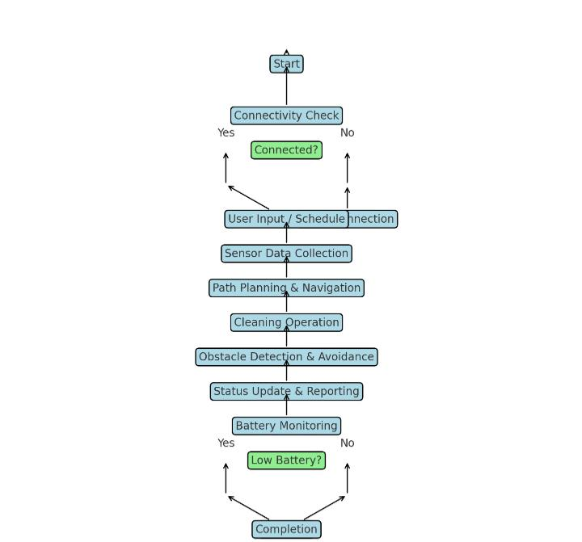
Flow Diagram:

Slide 6
Implementation: (Hardware or software)
Hardware:
Microcontroller: Manages operations.
Sensors: For obstacle and cliff detection.
Motors: For movement and suction.
Battery & Charging Dock: Powers the device and recharges it.
Dustbin: Collects debris.
IoT Module: Enables remote control via Wi-Fi/Bluetooth.
Software:
Firmware: Controls hardware operations and processes data.
Navigation Algorithms: Manages path planning and obstacle avoidance.
Remote Control Interface: Mobile app and/or voice command integration.
Battery Management: Oversees charging and power efficiency

Slide 7
Implementation:
Arduino:
Purpose: Arduino acts as the brain of the vacuum cleaner, controlling the motors, sensors, and other components.
Steps:
Connect Arduino: Plug the Arduino into your computer via USB.
Install IDE: Download and install the Arduino IDE.
Add Libraries: Install necessary libraries for your components.
Write/Load Code: Create or load your control code.
Compile: Check the code for errors.
Upload: Upload the code to the Arduino board.

Slide 8
Implementation:
Arduino Motor Shield :
Purpose: The motor shield enables you to control multiple DC motors simultaneously, crucial for vacuum movement.
Steps:
Mount Shield: Attach the motor shield to the Arduino.
Connect Motors: Plug in the DC motors.
Power Supply: Use an external power source if necessary.
Use Libraries: Include AFMotor in your code.
Test Motors: Check motor movement for correct setup

Slide 9
Implementation:
Servo Motor:
Purpose: Servo motors can be used for specific functions like rotating the cleaning brush or maneuvering sensors.
Steps:
Connect Servo: Attach the servo motor to a PWM pin.
Initialize: Use the Servo library in your code.
Program Movement: Set the angle and movement pattern.
Test: Run a sweep motion to check functionality.

Slide 10
Thank you

